Slide 1

Hotels Against Trafficking
By: Ngoc Tran
Thursday, September 12, 2019
Notes:
Image Source: https://talk1073.com/2019/08/12/no-room-for-trafficking/
My project is Hotels Against Trafficking and this is my very first step to battling sex trafficking.

Slide 2

Motivation
In the United States alone:
Approximately 75-80% of human trafficking and slavery is for sex
30,000 people die each year while being trafficked for sex from neglect, abuse, disease, or torture
Nearly 20,000 victims are sold and trafficked each year. This number includes the victims who are as young as 5 and 6 years of age
There have been approximately 100,000 to 150,000 sex slaves since 2001
Source: The Disturbing Reality of Human Trafficking and Children (Dec 18, 2016)
Notes:
Did you know that:
- Approximately 75-80% of human trafficking and slavery is for sex
- 30,000 people die each year while being trafficked for sex from neglect, abuse, disease, or torture
- Nearly 20,000 victims are sold and trafficked each year. This number includes the victims who are as young as 5 and 6 years of age
- There have been approximately 100,000 to 150,000 sex slaves since 2001
And all of these are just in the US alone. These statistics are from late 2016.
Things are probably much worse now, almost 3 years later. The good thing is that quite a few good people and organizations have already put in their effort to help eradicate these activities. I also want to be a part of it. And the best thing I can do is contributing what I do best: applying my skills and knowledge in the data science field.

Slide 3

Objectives
Problem:
Commercial sex within hotels and motels are most frequently advertised through online platforms (Backpage.com, Eros.com, etc.)
Goal:
Automatically classifying different hotel chains using Deep Learning
Source: The National Human Trafficking Hotline
Notes:
Image Source: https://www.knkx.org/post/seattle-confronts-child-prostitution-problem-after-fbi-sweeps
Commercial sex within hotels and motels are most frequently advertised through online platforms. Websites such as Backpage.com, Eros.com, and others are used as a platform for advertising the women, men, and youth engaged in commercial sex as well as a communication tool for setting up dates, times, and locations.
Traffickers (or at least some of them) force their victims to pose in hotel rooms so they can take pictures and advertise them on the dark web. Because of that, I want to build something that can automatically classify different hotels. This, though, can be a very challenging problem; therefore, my first step is to automatically classify different hotel chains using Deep Learning.

Slide 4



Images
3 hotel chains:
Two-star hotel chain, Comfort Inn
Three-star hotel chain, Best Western
Four-star hotel chain, Hilton
Training set:
12,000 (128,128,3) images
Validation set:
3,000 (128,128,3) images
Test sets:
Images are augmented with person-shaped masks of varying size splitted into 4 categories; each contains the same:
388 (128,128,3) Comfort Inn images
384 (128,128,3) Best Western images
249 (128,128,3) Hilton images
Source: A Global Hotel Recognition Dataset
Notes:
Image Sources:
[1] https://www.choicehotels.com/comfort-inn
[2] https://www.bestwestern.com/en_US.html
[3] https://www.hilton.com/en/hilton/
For this project, I only focus on 3 different hotel chains belonging to 3 different tiers:
Two-star hotel chain, Comfort Inn
Three-star hotel chain, Best Western
Four-star hotel chain, Hilton
The images are scraped from:
Publicly available travel websites, such as Expedia
Crowdsourcing mobile application, TraffickCam, which enables travelers to help combat sex trafficking by uploading photos of the hotel rooms in which they stay
I decide to use 5,000 (128,128,3) images for each hotel chains, totaling 15,000 (128,128,3) images. The data set is train test splitted 80/20 into a training set and a validation set.
To replicate real-world conditions, the images in the test set are augmented with person-shaped masks of varying size. Because of that, we end up with 4 different test sets; each contains the same:
388 (128,128,3) Comfort Inn images
384 (128,128,3) Best Western images
249 (128,128,3) Hilton images

Slide 5
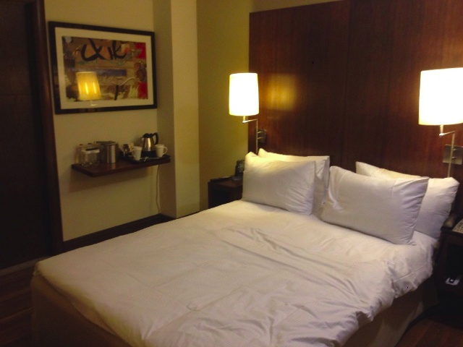
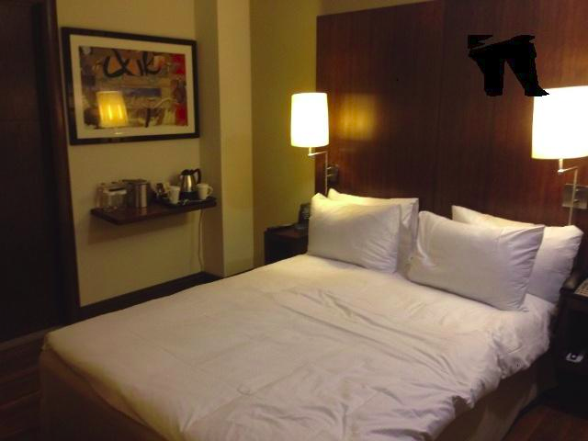
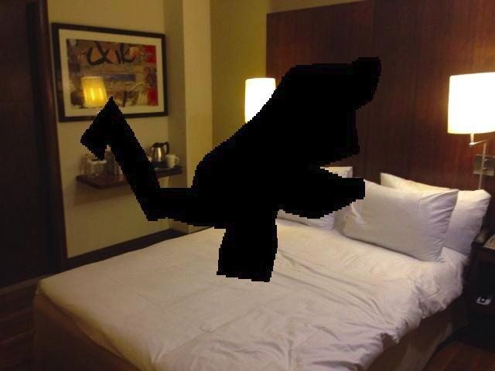
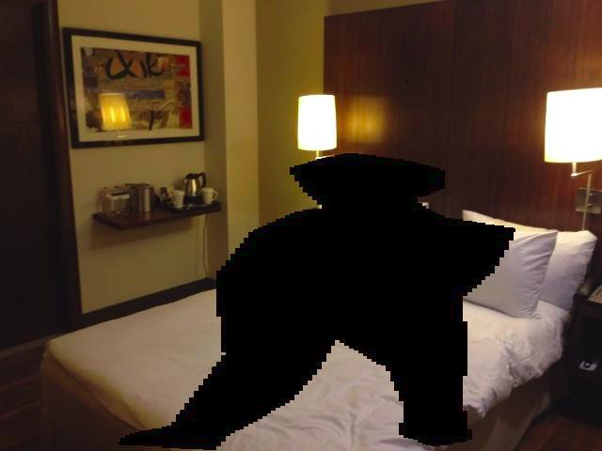
Test Sets
Unoccluded
Low Occlusions
Medium Occlusions
High Occlusions
Notes:
This is to show what I meant. The same image can be used in all 4 test sets, each with its own according mask.

Slide 6

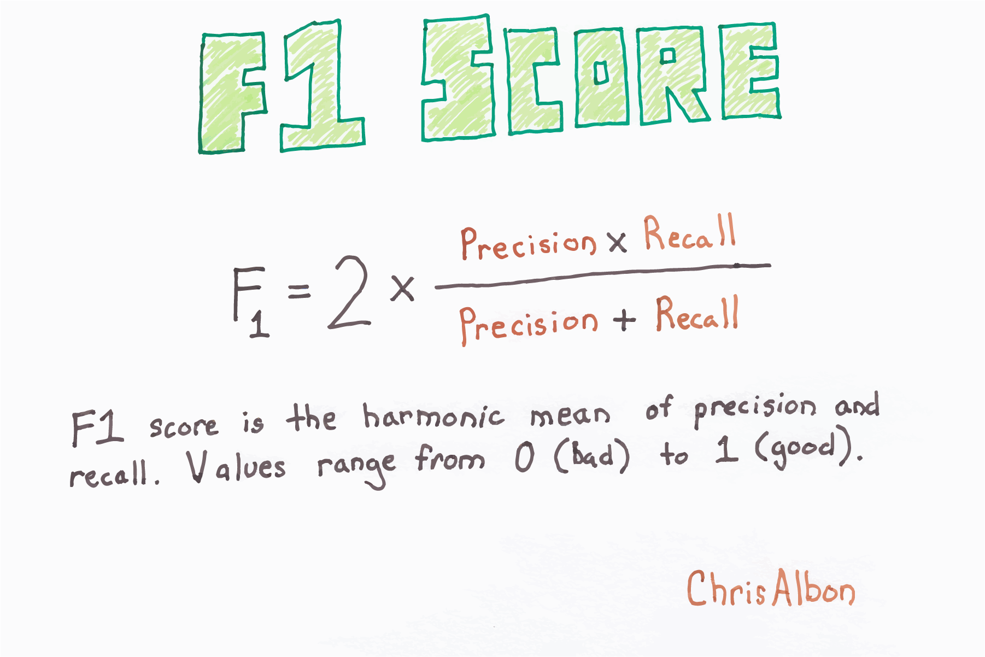
Best Model & Metrics
Best Model:
VGG-16 Deep Convolutional Neural Network pre-trained on ImageNet database
Last 5 layers unfrozen to allow for additional training on hotel chain database
Metrics:
Precision:
What proportion of positive identifications was actually correct?
Recall:
What proportion of actual positives was identified correctly?
F1-Score:
The harmonic mean of Precision and Recall
Source: Classification: Precision and Recall
Notes:
Image Sources:
[1] https://gluon-cv.mxnet.io/build/examples_datasets/imagenet.html
[2] https://chrisalbon.com/machine_learning/model_evaluation/f1_score/
I have built a lot of different models and so far, this one is the best:
A VGG-16 Deep Convolutional Neural Network pre-trained on ImageNet database with the last 5 layers unfrozen to allow for additional training on my hotel chain database
ImageNet is a dataset of over 15 millions labeled high-resolution images with around 22,000 categories. It is widely used in the research community for benchmarking state-of-the-art models.
The metrics I care about is the F1-score. But to understand it, we need to understand precision and recall.
Precision allows us to answer the following question: "Out of all the times the model says ‘this is a Hilton hotel,’ how many times is the hotel of interest actually Hilton?"
Recall allows us to ask: "Out of all the Hilton hotels, what percentage of them does our model correctly identify as Hilton hotels?"
F1-score cannot be high without both precision and recall also being high. High F1-score allows for more victims to be rescued while wasting less effort of the authorities, of anyone involved.

Slide 7
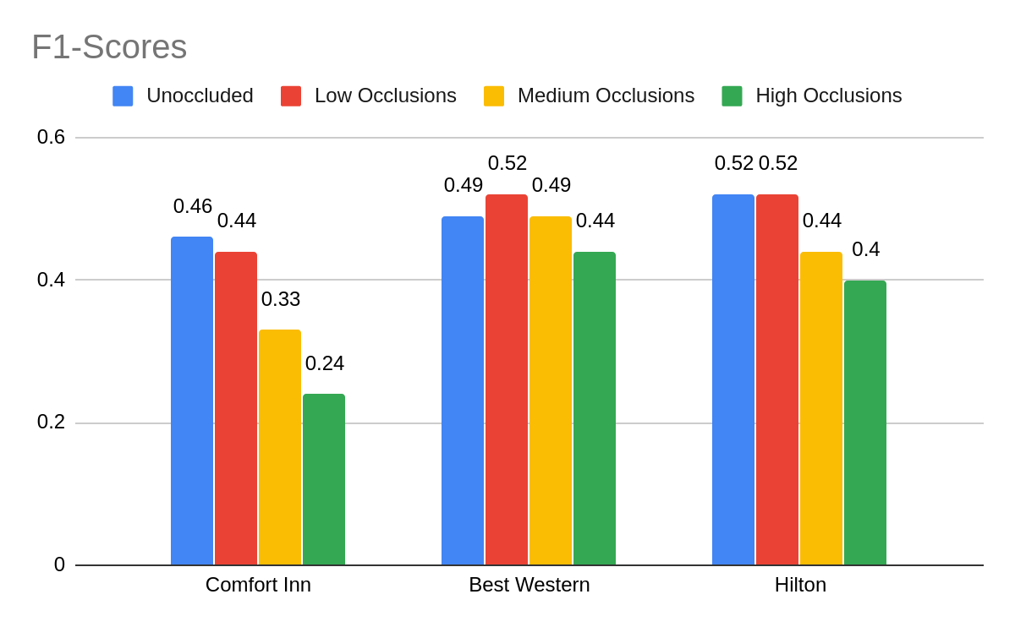
Results
Notes:
These are the results from the best model.
Since we have a balanced dataset with 3 classes, an F1-score of larger than 33% is better than random.
Here, you can see that besides Comfort Inn's Medium Occlusions case which is as good (bad) as random chance and High Occlusions case which is worse than random chance, everything else is better than random.

Slide 8
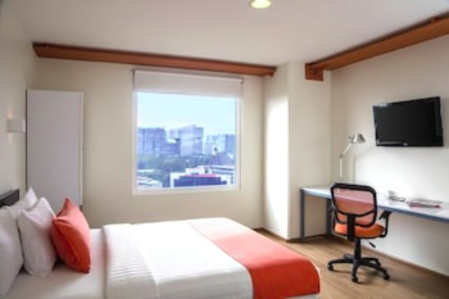
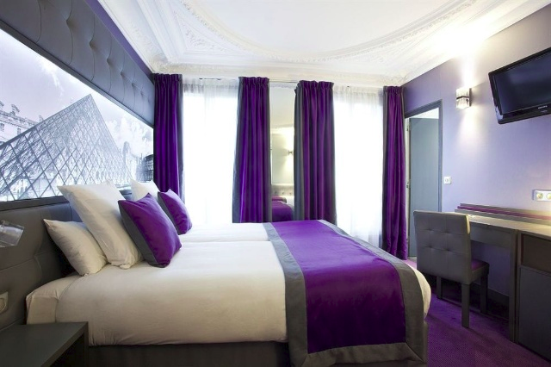
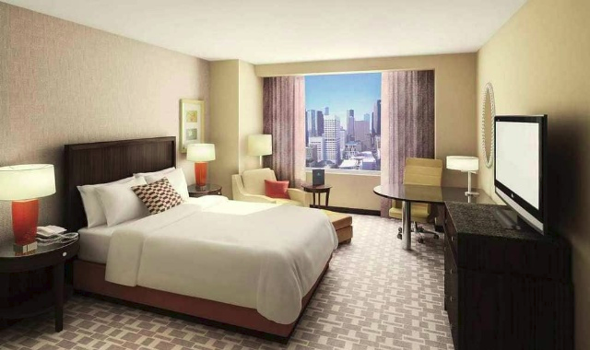
Difficulties
Comfort Inn
Best Western
Hilton
Notes:
It's understandable that the results aren't as good as I hope they would be. Honestly, I cannot tell myself which hotel chains these rooms belong to.

Slide 9
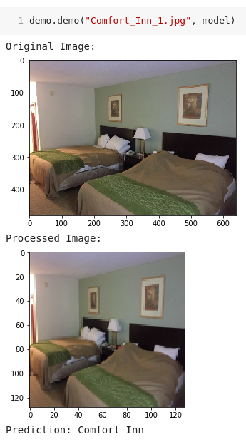
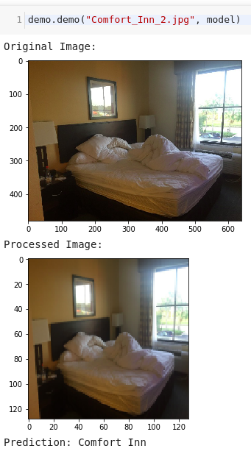
Demo - Comfort Inn

Slide 10
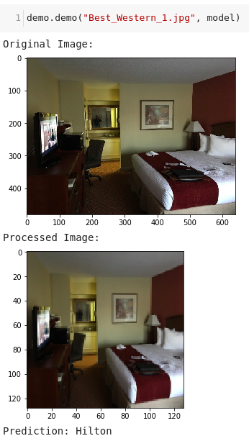
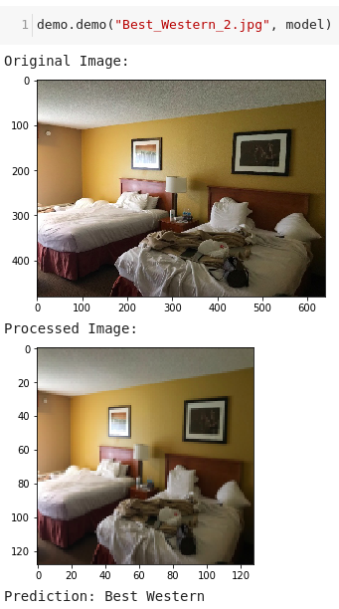
Demo - Best Western

Slide 11
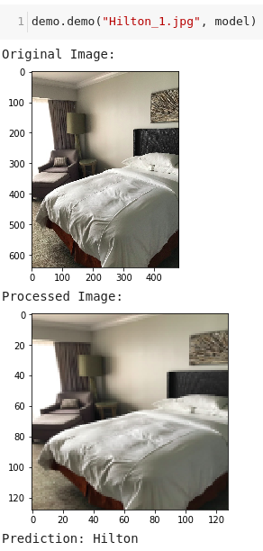
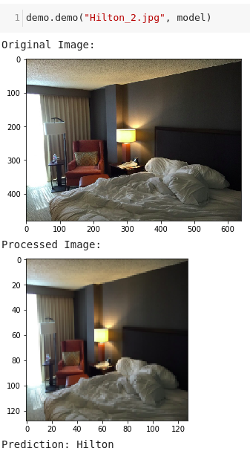
Demo - Hilton

Slide 12

Next Steps for Future Improvements
Further fine-tuning the best model
Further fine-tuning other Deep Convolutional Neural Network models
Notes:
Image Source: Fine-tuning XGBoost in Python like a boss
Since I’m not entirely happy with the results, I want to further fine-tune both the best model and the other DCNN models to see if I can get better results.

Slide 13
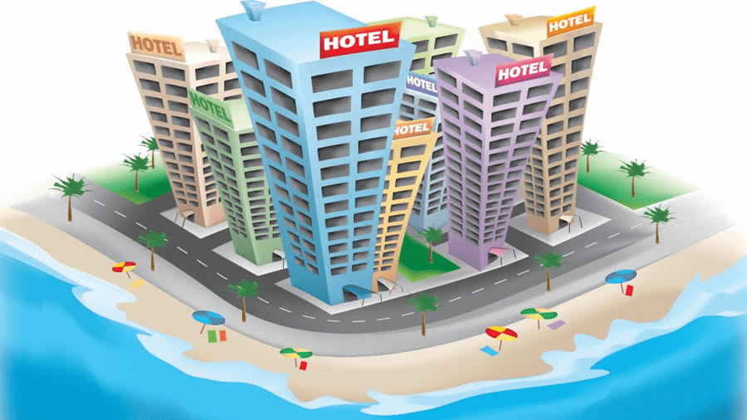
Future Plans
Automatically classifying different hotels and motels using Deep Learning
Notes:
Image Source: https://zualetech.com/zuotel-hotel-booking-and-management-system/
As I mentioned, this project is just the very first step to combating sex trafficking. I want to be able to automatically classify different hotels and not different hotel chains. Once I have a decent working model, I want to present to it to people and maybe get my model used by organizations and/or agencies.

Slide 14
Questions?

Slide 15
THANK YOU!

Slide 16
Sources
https://keras.io/models/sequential/
https://keras.io/applications/
https://keras.io/callbacks/
https://keras.io/layers/core/
https://keras.io/layers/normalization/
https://keras.io/utils/
https://scikit-learn.org/stable/modules/generated/sklearn.model_selection.train_test_split.html
https://scikit-learn.org/stable/modules/model_evaluation.html#classification-metrics
https://pypi.org/project/opencv-python/

Slide 17
Contact Information
GitHub: https://github.com/nt-ds/hotels-against-trafficking
LinkedIn: https://www.linkedin.com/in/nt-ds/
Email: ntran19@jhu.edu
Medium: https://medium.com/@ntran19

